Slide 1
UCSD Embedded Linux Assignment 7
By
Hsuankai Chang
hsuankac@umich.edu

Slide 2
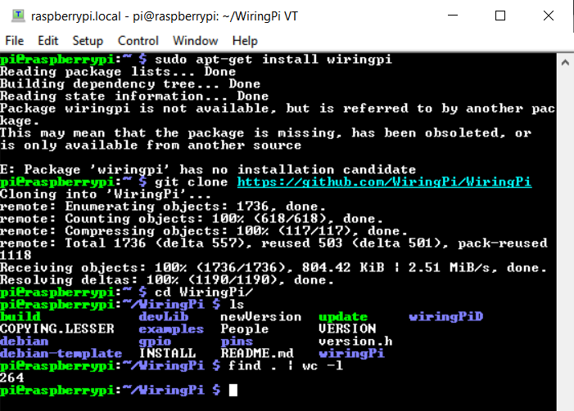
Step 1. Try to install wiringpi library

Slide 3
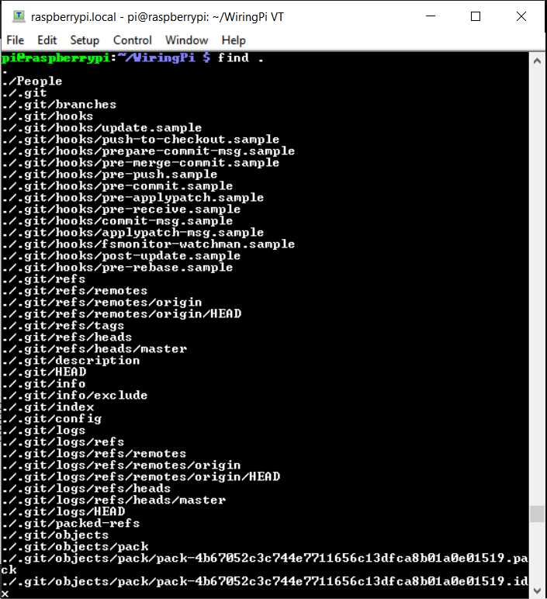
Step 2. find . In WiringPi

Slide 4
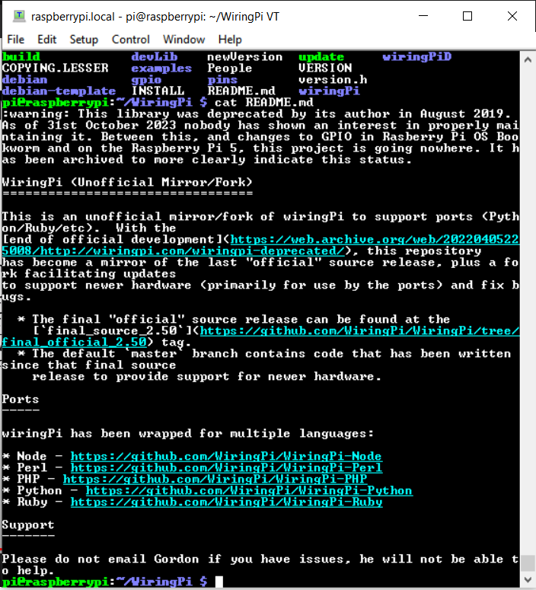
Step 3. WiringPi README.md file

Slide 5
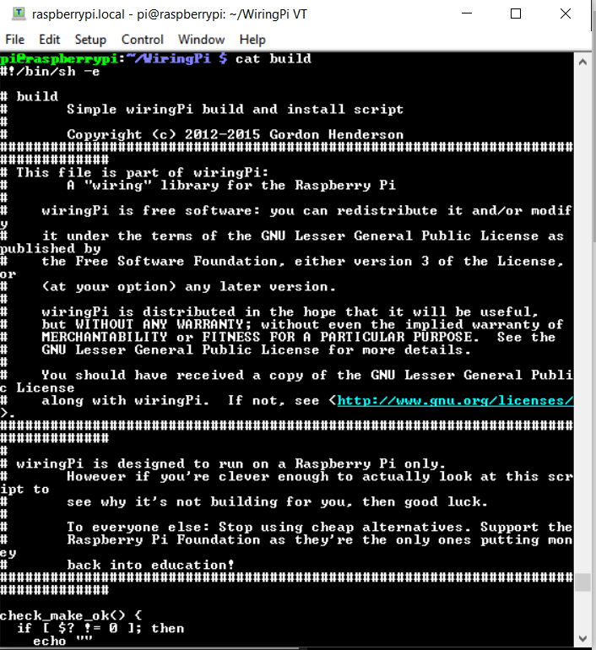
Step 4. Viewing the build script

Slide 6
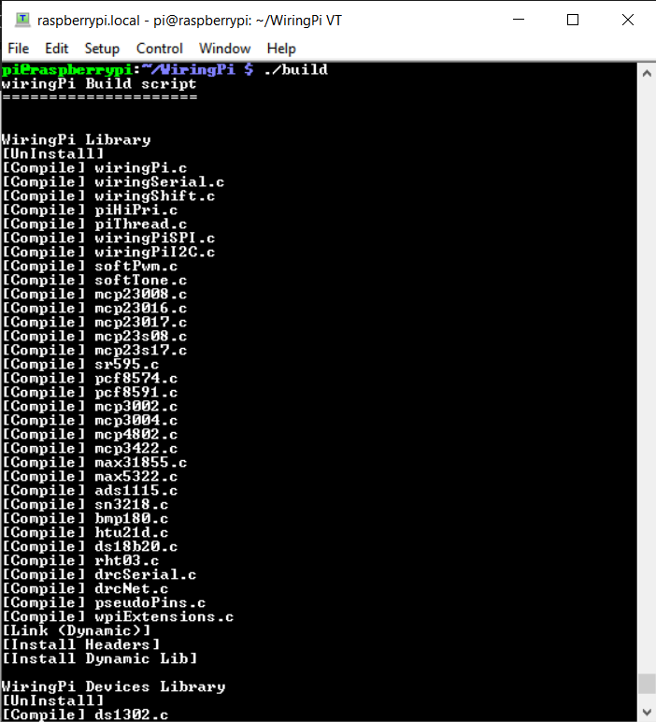
Step 5. Build WiringPi

Slide 7
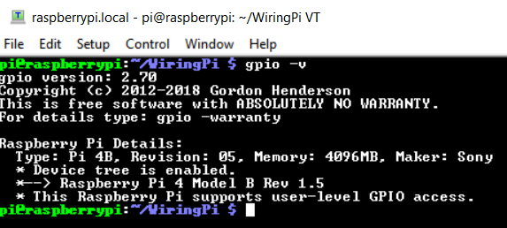
Step 6. gpio –v command

Slide 8
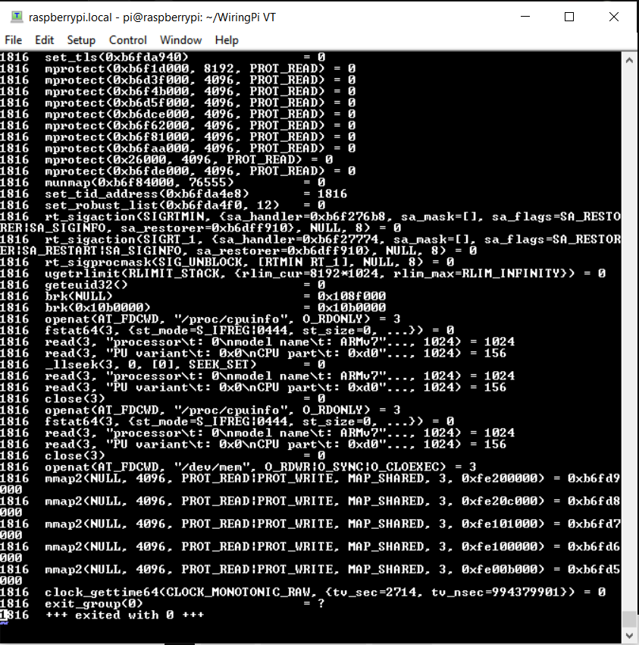
Step 7. strace -f -o /tmp/gpio.trace gpio write 21 1

Slide 9
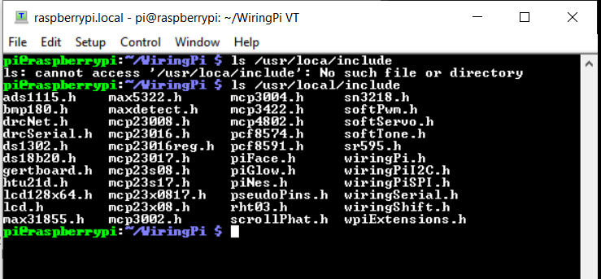
Step 8. /usr/local/include

Slide 10
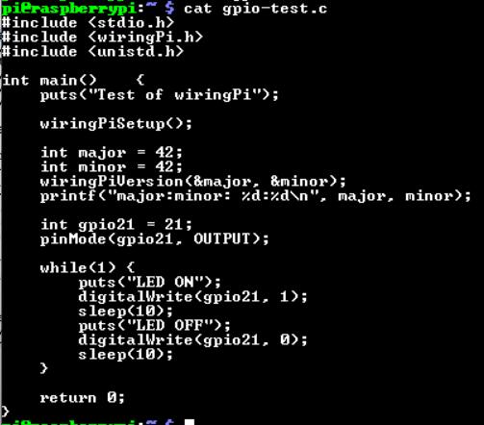
Step 9. gpio-test.c file

Slide 11
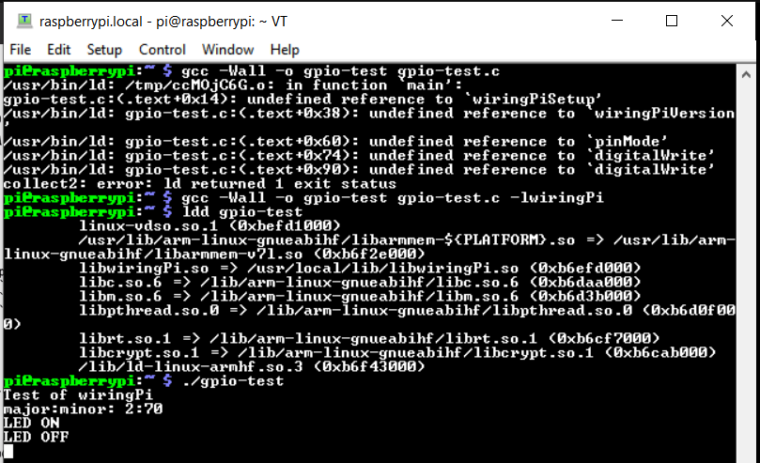
Step 10. Build and run the gpio-test.c file

Slide 12
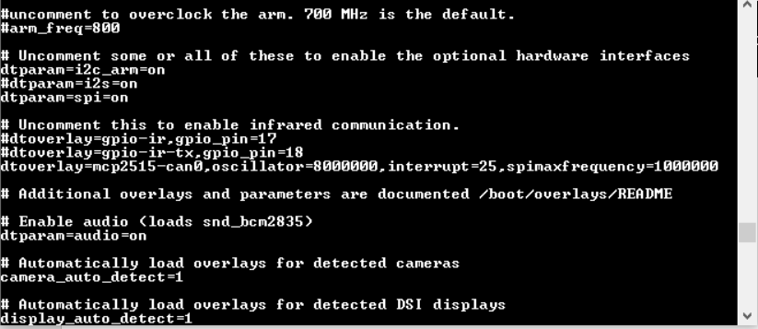
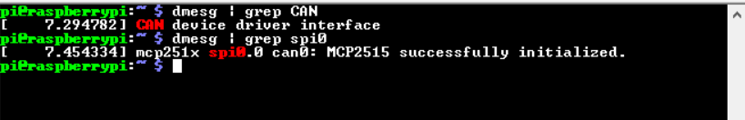
Step 11. Edit the /boot/config.txt file, reboot and check the interface

Slide 13
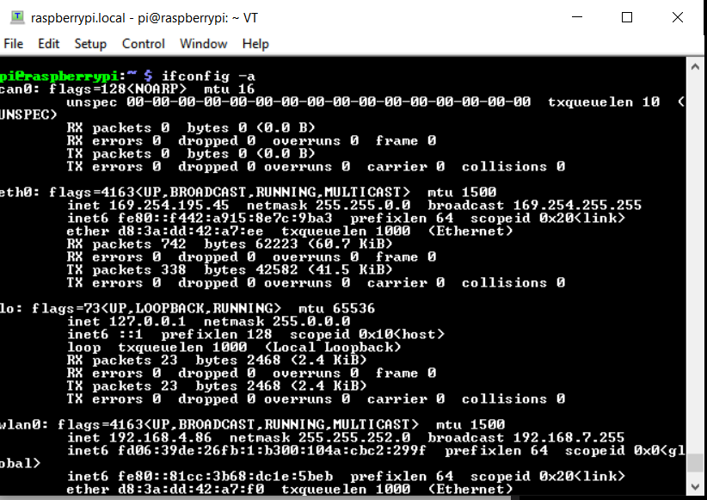
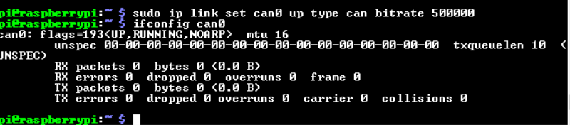
Step 12. ifconfig –a, setup the bitrate and ifconfig can0

Slide 14
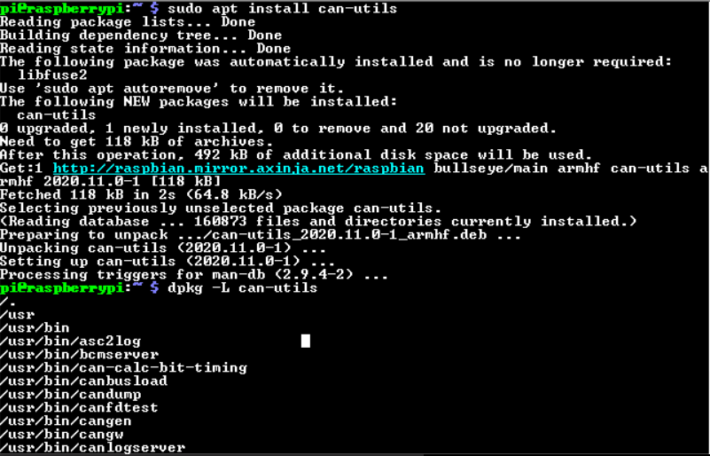
Step 13. can-utils

Slide 15
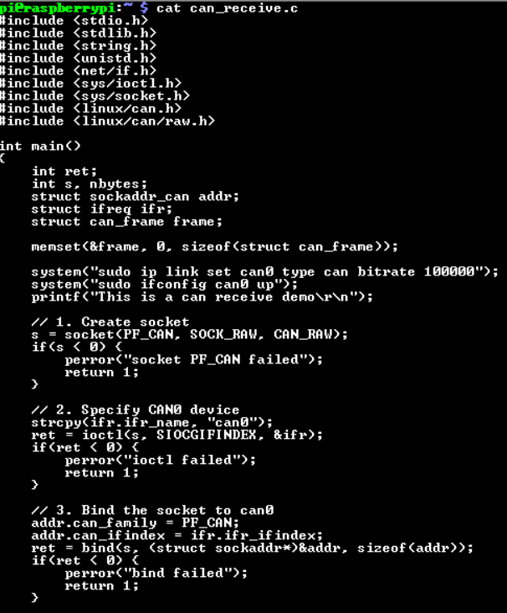
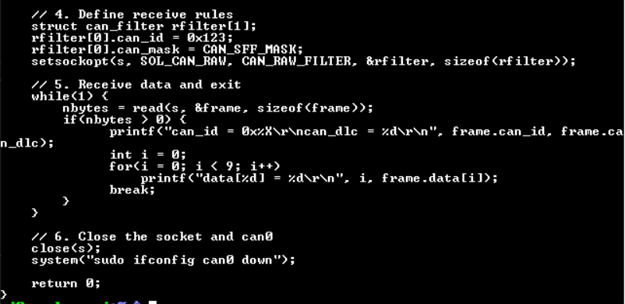
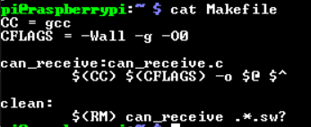
Step 14. can_receive.c and Makefile

Slide 16

Step 15. Build and run the code

Slide 17
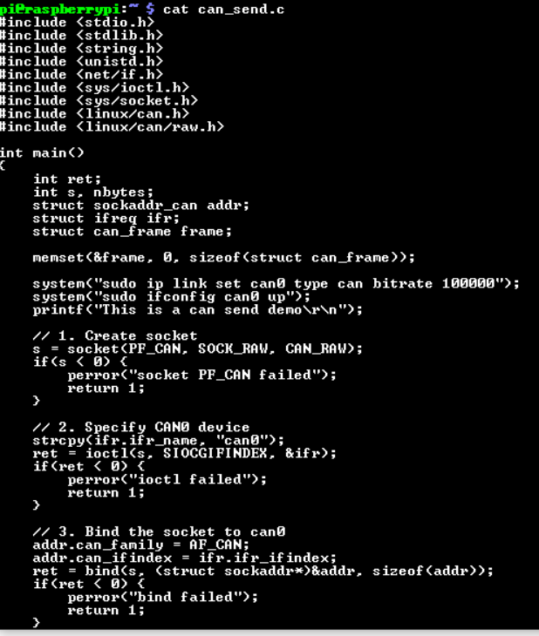
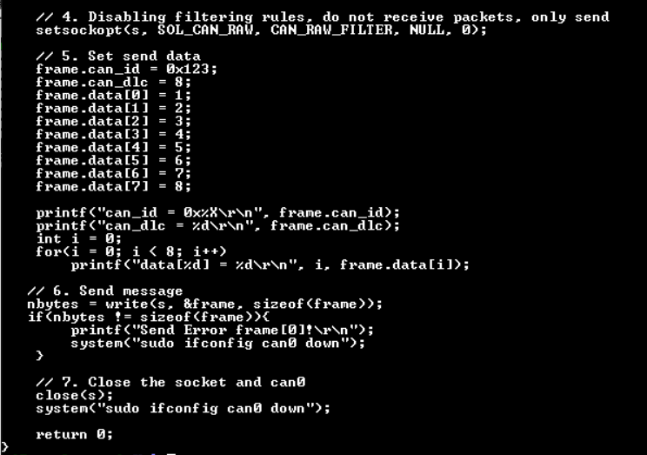
Step 16. can_send.c file

Slide 18
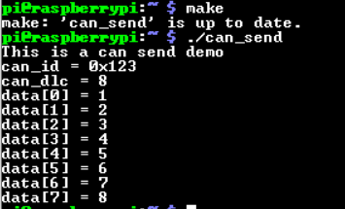
Step 17. Build and run the code

Slide 19
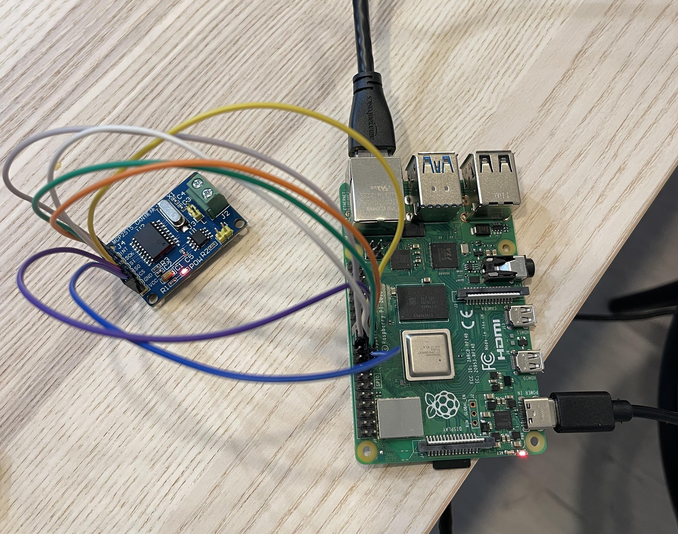
Appendix, hardware connection, using cheaper version of MCP2515 CAN module

